Slide 1
Introduction
Vehicle systems
Ing. Rozhdestvenskiy Dmitry

Slide 2
Lectors
Doc. Ing. Petr Bouchner Ph.D.
  Email: bouchner@lss.fd.cvut.cz
  Room: A-348 (Building Horska 3)
  Office hours (email arrangement)
Ing. Rozhdestvenskiy Dmitry Ph.D.
  Email: rozhddmi@fd.cvut.cz
  Room: A-346 (Building Horska 3)
  Mondays only.

Slide 3
Student intrudoction
Please stand up and tell us about yourself.
  Where are you from
  Background
  Area of interest / master thesis topic (if have one)
  What do you want to get from this subject.

Slide 4
Assessment Conditions
Attendance 80%
  Oral questions during the exam on a topic of missed lectures
Preparation presentation on a State-of-the-art IVS
  5 – 10 minute presentation in front of the class (last lecture)
  5 questions with multiple choice answers (one of them will be included in the final test)
Practice (Develop a vehicle simulation system )
  Brake into 4 teams
  Collaboration via GitHub repositories
    Tasks are delivered as a Pull Requests
Final examination
  Multiple choice test approximately 30 questions.
  Oral examination if not satisfied with the assesment

Slide 5
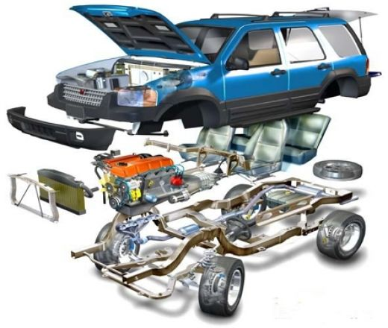
Subject goals and prerequisites
Goal of the course is to give you a knowledge about
  Basic features of regulatory technology and theory of control.
  Dynamic properties of a vehicle and driver as a regulator
  Car communication bus
  Electric cars and its components. DC devices, asynchronous engines, synchronous engines - principles, construction, elementary features and operation
  Hybrid drive system.
  Control, safety, communication and comfort electronic
  systems in a car.
Typical Lecture structure
  Introduction (purpose, functions)
  Physics behind the system
  Description of main components
  Description of algoritms and control strategy
Typical Practice structure
  Remainder of the theory behind
  Creation of the model (guided by me)
  “Playing” with model to achieve desired task
  Writing a small report cca 0.5 – 1 page at home

Slide 6
DYAD JuliaSim, We are going to develop a library to test different vehicle systems
  Focus on 1D vehicle motion only
    Engine
    Wheels
    Transmission
    Brakes
    Driver
  Develop main components and preform a set of simulations
    Adaptive Cruise Control
    ABS system and control
https://help.juliahub.com/dyad/dev/

Slide 7
Date | Topic | Practical tasks
 | Introduction Lecture
 | PID Controllers and Vehicle Dynamics
 |  | Introduction to DYAD
 | Engine systems CAN BUS interface
 |  | USB CAN BUS, Engine modeling WAVE
 | Active and Passive Safety system
 |  | PID controllers ,Vehicles resistance
 | Driver comfort and Assistant system
 |  | In class work on the assisment
 | Hybrid and Electric
 |  | In class work on the assisment
 | Fuel Cells
 | Autonomous vehicle Student presentations
 | Firs exam term

Slide 8
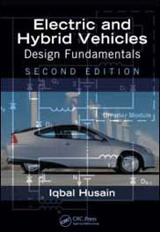
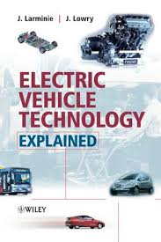
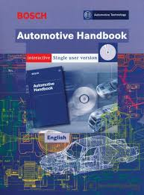
Recommended Literature
John Lowry, James Larmine, Electric vehicles technology explained
Kuo B. C.: Digital Control Systems.
Bosch Automotive Handbook, 9th Edition Published by Robert Bosch with a Product Code of BOSCH, ISBN of 978-0-7680-8152-7,
Iqbai Husain Electric and Hybrid Vehicles Design Fundamentals

Slide 9
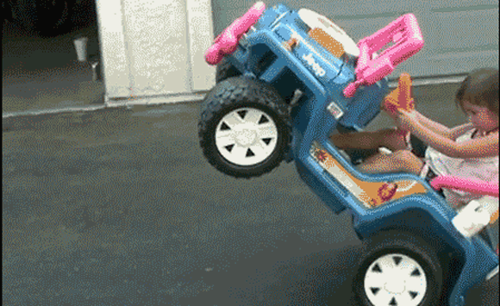
It’s all for now see you next week

